Slide 1

MAJOR PROJECT REPORT
Innovative Intrusion Detection Systems for Enhancing Security in Internet of Vehicles Using Advanced Machine Learning Techniques
Submitted in partial fulfilment of the requirement for the award
Of
BACHELOR OF TECHNOLOGY IN COMPUTER SCIENCE ENGINEERING
UNDER THE GUIDANCE OF
Mr. SATISH KUMAR NEGI
(Asst. Prof., Dept. of Computer Science & Engineering)
Presented by:
Abhay Sonu Thakur (21027101)
Ajay Kumar Sharma (21027106)
DEPARTMENT OF COMPUTER SCIENCE & ENGINEERING, SCHOOL OF STUDIES ENGINEERING & TECHNOLOGY
GURU GHASIDAS VISHWAVIDYALAYA,
KONI, BILASPUR, (C.G), INDIA
December - April 2025

Slide 2


Content
Introduction
Problem statement
Objectives
Dataset
Methodology
Result And Conclusion
References
Thanks

Slide 3
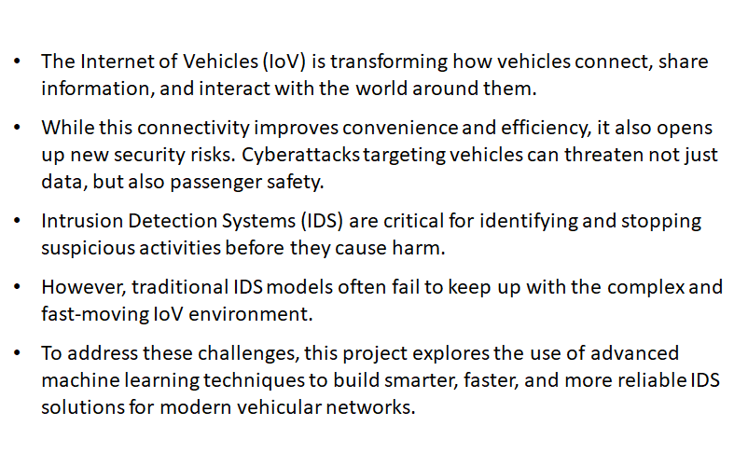
Introduction

Slide 4
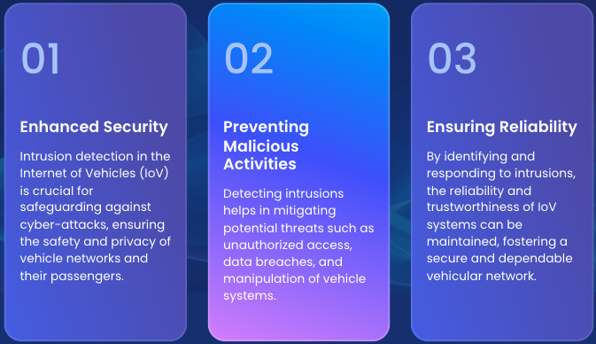
Problem Statement
As vehicles become increasingly connected through the Internet of Vehicles (IoV), they are also becoming prime targets for cyberattacks.
Existing Intrusion Detection Systems (IDS) struggle to handle the vast amount of real-time data, diverse attack types, and rapidly changing network behaviors
Traditional security systems are often reactive, slow, and not designed for the highly dynamic and mobile environment of IoV.

Slide 5
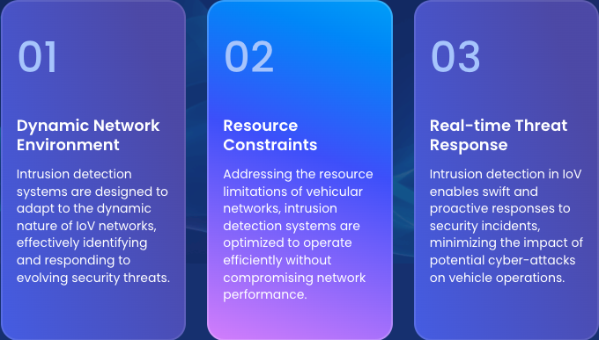
Problem statement
There is a growing need for intelligent, adaptive, and lightweight IDS solutions that can detect intrusions accurately without impacting vehicle performance.
There is a critical need for intelligent IDS solutions that can proactively detect and respond to threats in real-time, ensuring the safety and reliability of vehicular communications.
This project aims to solve these challenges by applying advanced machine learning techniques to develop a smarter, faster, and more efficient IDS for the Internet of Vehicles.

Slide 6
Objectives
Design an intelligent Intrusion Detection System (IDS) tailored for the Internet of Vehicles (IoV) environments.
Leverage advanced machine learning algorithms to improve the detection of known and unknown cyber threats.
Enhance real-time threat detection capabilities while maintaining low computational overhead for vehicular networks.
Ensure adaptability and scalability of the IDS to meet future IoV security needs.Benchmark and validate the system’s performance using realistic vehicular network datasets (CICIDS2017-18).
Promote safer vehicular communication networks by proactively identifying and mitigating security risks.

Slide 7
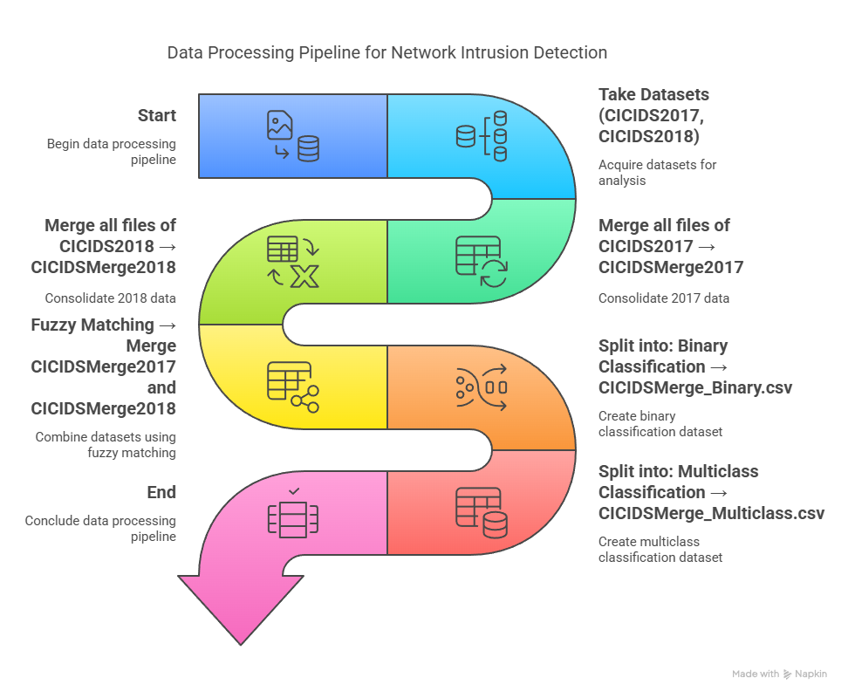
DATASET Overview

Slide 8
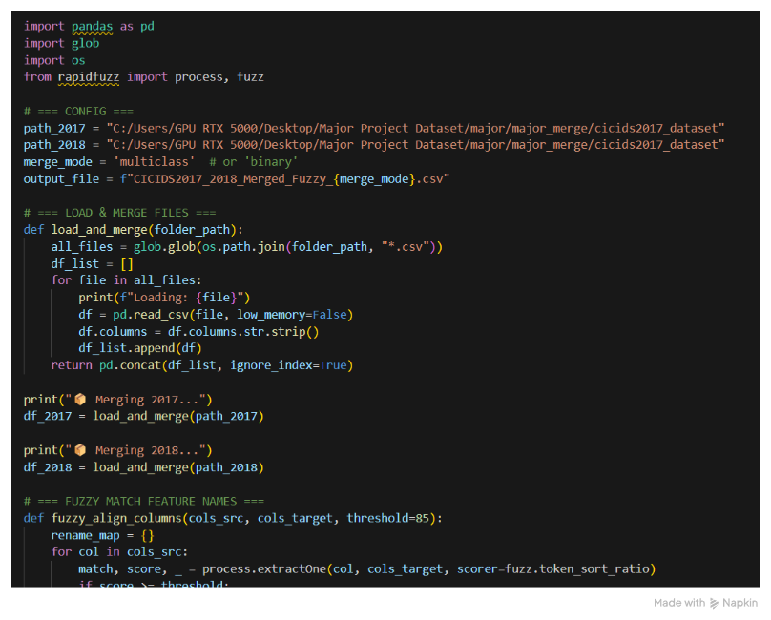
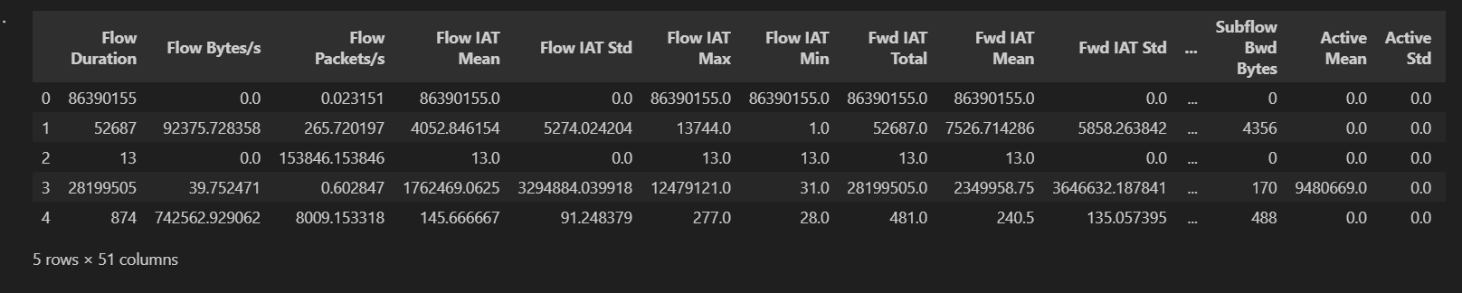

Slide 9
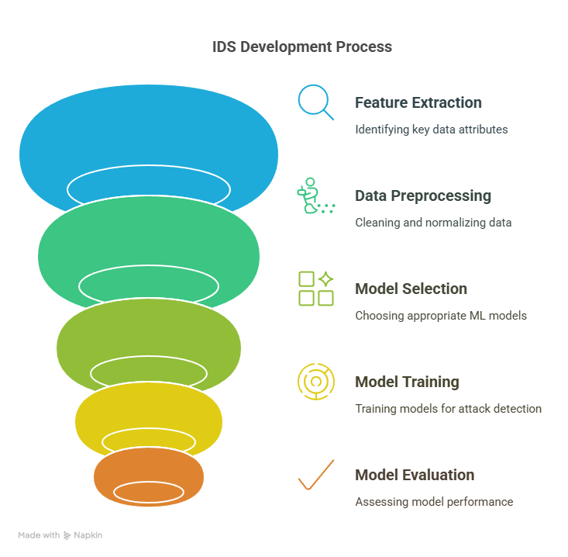
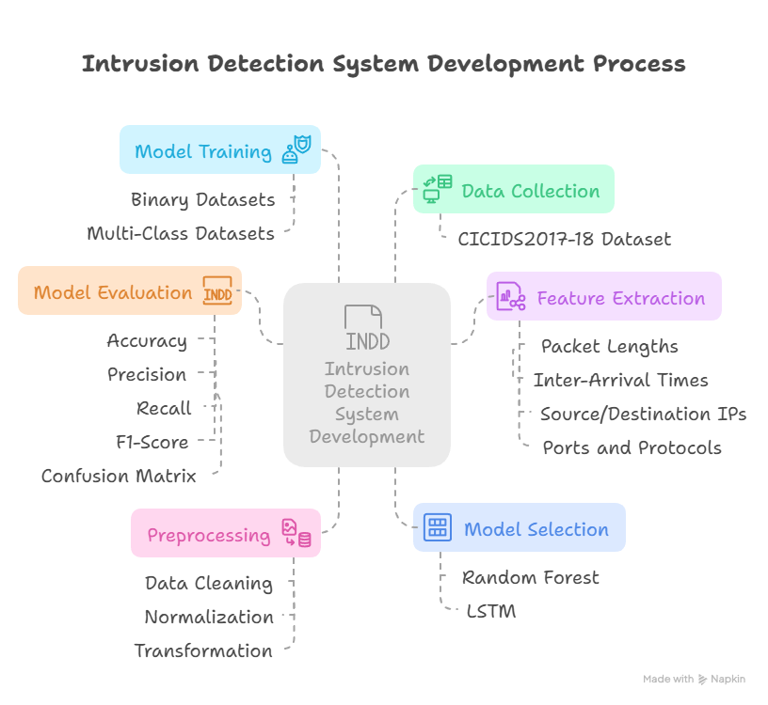
Methodology

Slide 10
Model Selection
Feature | Random Forest (RF) | Long Short-Term Memory (LSTM)
Learning Type | Ensemble of Decision Trees | Recurrent Neural Network (RNN)
Best for | Structured/tabular data | Sequential/time-dependent data
Handling Overfitting | Yes, via bagging | Needs careful tuning
Strength | High accuracy, feature ranking | Long-term memory, pattern detection
Common Application | Static data analysis, classification | Dynamic prediction, anomaly detection

Slide 11
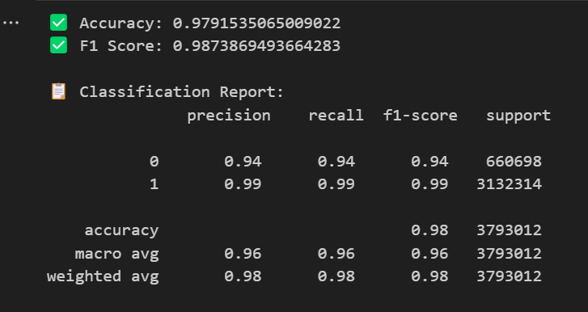
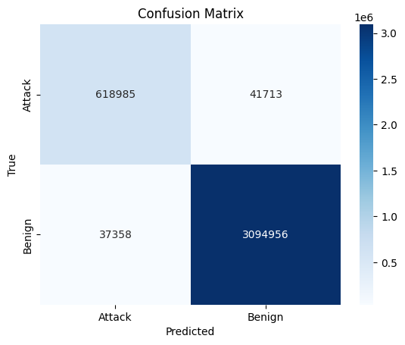
Result & Conclusion
Output of Random Forest: Binary Classification
Confusion Matrix of Random Forest: Binary Classification

Slide 12
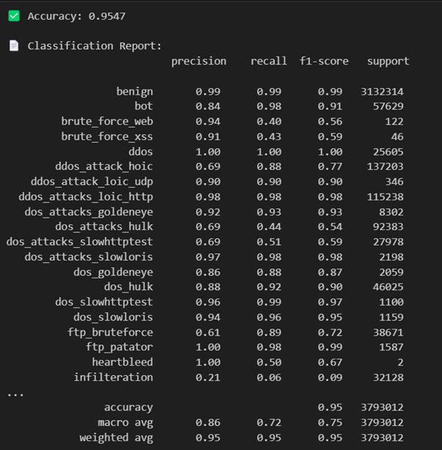
Result & Conclusion
Output of Random Forest: Multiclass Classification

Slide 13
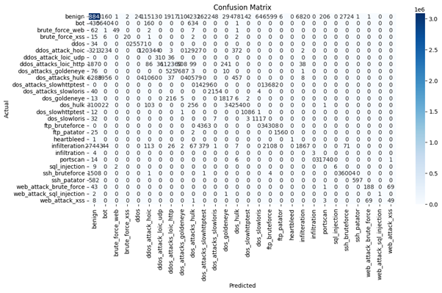
Result & Conclusion
Confusion Matrix of Random Forest: Multiclass Classification

Slide 14
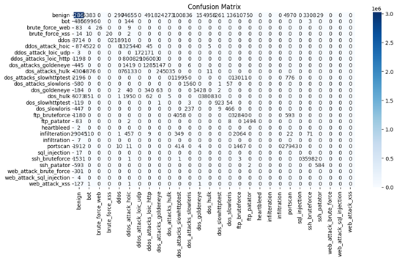
Result & Conclusion
Confusion Matrix of LSTM: Multiclass Classification

Slide 15
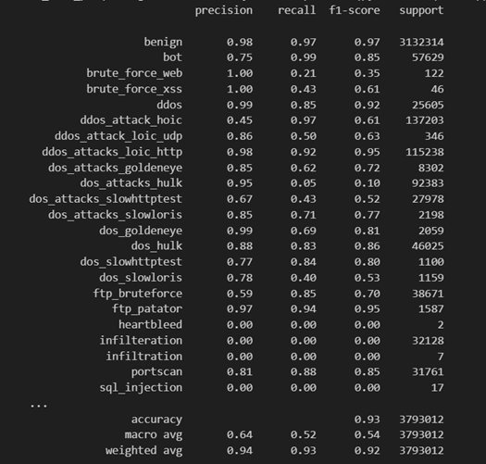
Result & Conclusion
Output of LSTM: Multi Classification

Slide 16
REFERENCES
[1] Y. Li, S. Sun, and J. Han, "TCAN-IDS: Temporal CAN Intrusion Detection System using Convolutional Neural Networks," IEEE Access, vol. 8, pp. 133615–133624, 2020.
[2] M. Soni and S. R. Alavandar, "MTH-IDS: Multi-Tiered Hybrid Intrusion Detection System for Vehicular Networks," Procedia Computer Science, vol. 192, pp. 4190–4198, 2021.
[3] W. Wu, J. H. Joloudari, S. K. Jagatheesaperumal, K. N. V. P. S. Rajesh, S. Gaftandzhieva, S. Hussain, R. Rabih, N. Haqjoo, M. Nazar, and H. Vahdat-Nejad, "Deep Transfer Learning Techniques in Intrusion Detection System-Internet of Vehicles: A State-of-the-Art Review," Computers, Materials & Continua, vol. 80, no. 2, pp. 1975–1994, 2024.
[4] S. Sharma and M. Singh, "Machine Learning Technologies for Secure Vehicular Communication in IoV," Security and Communication Networks, vol. 2021, Article ID 8868355, 2021.
[5] M. Kim and J. Lee, "Security of Autonomous Vehicles: 5G IoV Environment," ISPRS International Archives of the Photogrammetry, Remote Sensing and Spatial Information Sciences, vol. XLVIII-4/W1-2020, pp. 267–273, 2020.

Slide 17
REFERENCES
[6] W. Elgenaidi and M. Rao, "Intrusion Detection System for Autonomous Vehicles Using Non-Tree Based Machine Learning Algorithms," Electronics, vol. 13, no. 5, pp. 1–20, 2024.
[7] Y. Li and W. Wei, "Federated AI-Enabled In-Vehicle Network Intrusion Detection for IoV," IEEE Transactions on Intelligent Transportation Systems, vol. 24, no. 5, pp. 4768–4778, May 2023.
[8] L. Yang, B. Liu, H. Zhang, and Y. Liu, "FL-MAAE: Intrusion Detection for IoV with Federated Learning and Memory-Augmented Autoencoder," Information Sciences, vol. 608, pp. 409–421, 2022.
[9] C. Song, Q. Pei, and C. Zang, "Intrusion Detection in Intelligent Connected Vehicles Based on Weighted Self-Information," IEEE Internet of Things Journal, vol. 10, no. 4, pp. 3695–3707, 2023.
10] I. Sharafaldin, A. H. Lashkari, and A. A. Ghorbani, "CICIDS2018: Toward a realistic benchmark for network intrusion detection systems," Canadian Institute for Cybersecurity, University of New Brunswick, 2018. [Online]. Available: https://www.kaggle.com/datasets/sampadab17/cicids2018
[11] I. Sharafaldin, A. H. Lashkari, and A. A. Ghorbani, "Toward Generating a New Intrusion Detection Dataset and Intrusion Traffic Characterization," in Proceedings of the 4th International Conference on Information Systems Security and Privacy (ICISSP), 2018, pp. 108–116

Slide 18
REFERENCES
[[12] M. Tavallaee, E. Bagheri, W. Lu, and A. A. Ghorbani, "A Detailed Analysis of the KDD Cup 99 Data Set," in Proceedings of the 2009 IEEE Symposium on Computational Intelligence for Security and Defense Applications, Ottawa, ON, Canada, 2009, pp. 1–6.
[13] M. A. Ambusaidi, X. He, P. Nanda, and Z. Tan, "Building an Intrusion Detection System Using a Filter-Based Feature Selection Algorithm and Random Forest Classifier," IEEE Transactions on Computers, vol. 65, no. 10, pp. 2986–2998, Oct. 2016.
[14] S. Axelsson, "Intrusion Detection Systems: A Survey and Taxonomy," Technical Report No. 99-15, Department of Computer Engineering, Chalmers University of Technology, March 2000.
[15] I. Sharafaldin, A. H. Lashkari, and A. A. Ghorbani, "Toward Generating a New Intrusion Detection Dataset and Intrusion Traffic Characterization," in Proceedings of the 4th International Conference on Information Systems Security and Privacy (ICISSP), 2018, pp. 108–116. [Online]. Available: https://www.unb.ca/cic/datasets/ids-2017.html

Slide 19



Thank you

